Slide 1
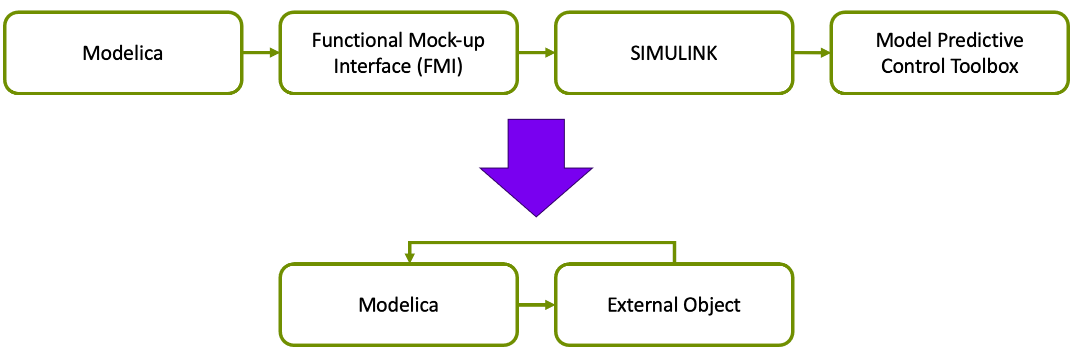
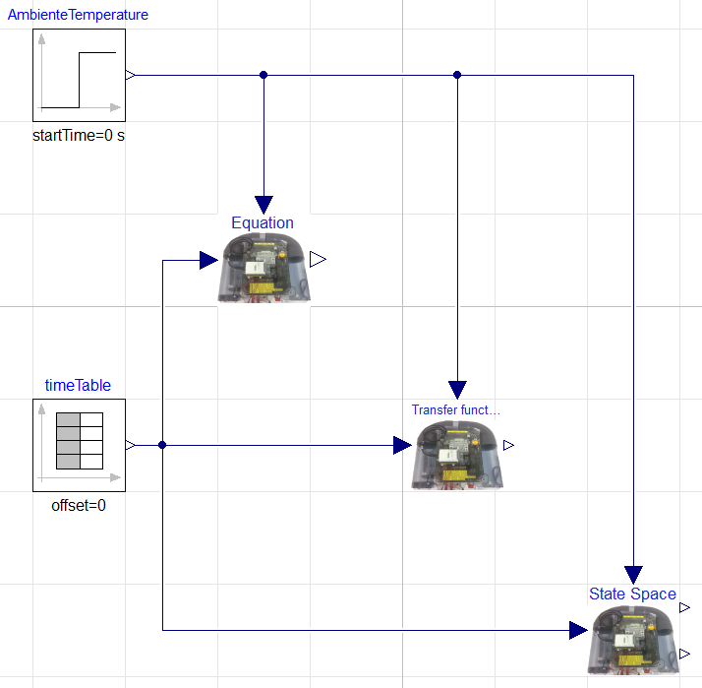
Advanced Control Implementation with Modelica
Master’s thesis number: MT-28-23
Introduction and background:
In the absence of inherent support for advanced control methods in Modelica, the current workflow as displayed in Figure 1, consisting of generating models within Modelica. Subsequently, the models are exported as functional mock-up units (FMUs) to SIMULINK. Within SIMULINK the MPC block in the model predictive control toolbox is utilized to compute the control signal.
Figure 1: Current workflow
Problem description and objective:
Yara's goal is to enhance efficiency by centralizing the entire system within Modelica. An option under consideration involves the integration of an MPC block directly into the Modelica environment.
Figure 2: Future workflow
Candidate:
Carl Magnus Bøe
Telephone:
95746478
Email:
228755@usn.no

